Slide 1
1. Capture the key issues you are facing today

Slide 2
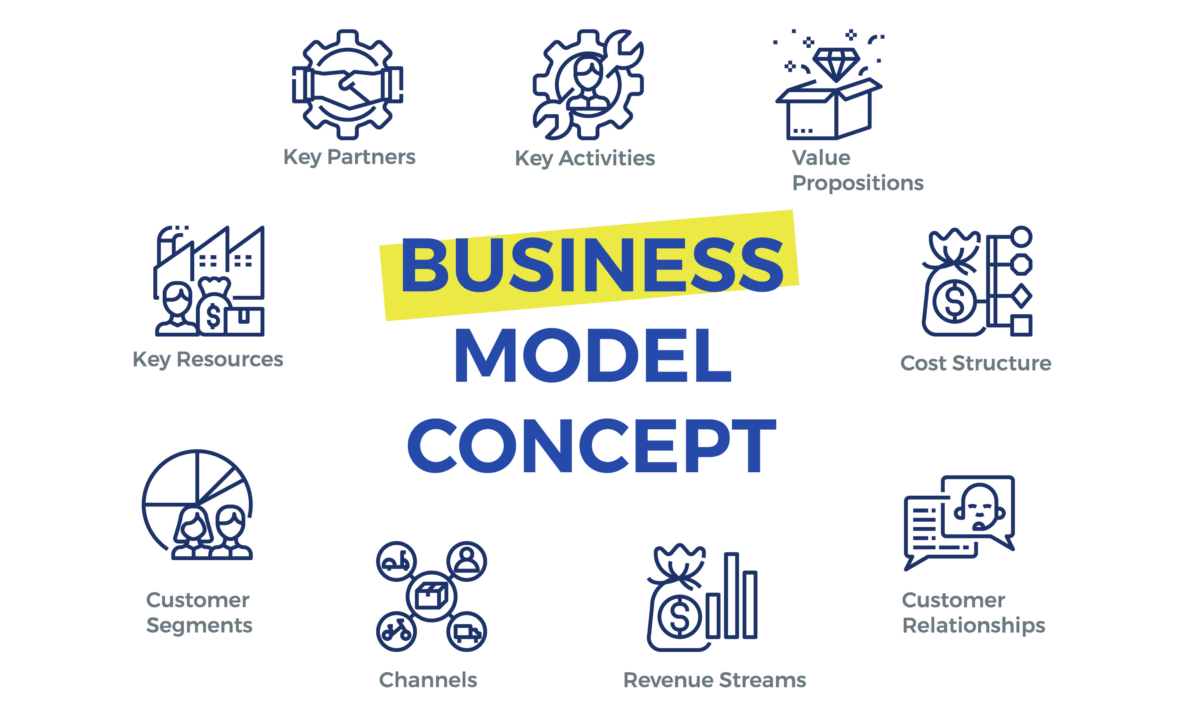
2. Identify how this may impact your business

Slide 3
Business Model Canvas
Key Partners & Suppliers
Key Activities
Value
Propositions
Customer
Relationships
Customer
Segments
Distribution Channels
Key Resources
Costs and Cash Outgoings
Revenue & Cashflow
Source : www.businessmodelgeneration.com

Slide 4
8
Key Activities
6
Value
Propositions
5
Customer
Relationships
Customer
Segments
Business Model Canvas
Propter questions
Key Partners & Suppliers
2
1
Which activities that you undertake to run your business will be most impacted by changes such as staff illness, lockdown etc.?
What should you stop/start/ramp up?
How else could you deliver ?
What is the most valuable benefit you provide to your key customer segments?
How can you protect those benefits to ensure they continue to be delivered - if not now, but in the future?
Or could you even improve or change your value proposition in the short term to attract sales?
If you are mainly face to face how can you change that to be digital?
How can you build trust with your key stakeholders?
How do your customer segments look in a COVID-19 environment?
Which ones will be impacted - light, medium or heavy?
What % of sales could be affected?
How does this flow through to sales – attempt to model
What are customers communication needs?
How is COVID-19 impacting your key suppliers and partners?
What flow on impact would this have for your business?
What are the alternatives – e.g. new suppliers or partners, changing mix etc?
What are their communication needs?
4
Distribution Channels
Do you go direct to customer or via a channel – e.g. referral, partner, associations etc?
How will they be impacted and what is the flow on impact for you?
Are there alternative routes to customers?
7
Key Resources
What is the impact on people, supplies, facilities, systems?
What are the mission critical roles?
What are staff’s communication needs?
Costs and Cash Outgoings
9
Revenue & Cashflow
3
What costs should you stop or defer?
Can you liquidate any assets to free up cash?
How can the bank help you in terms of debt?
Priority 1 – map out your cashflow – where are the key challenges?
Identify impact to revenue and cash from the business model elements (above)
Identify debtors that are at risk
Source : www.businessmodelgeneration.com , Leunig Advisory

Slide 5
Scenarios
Severity | Impact | Actions
Light
Medium
Heavy

